Slide 1
Chapter 1: Everything is Connected
IOT CƠ BẢN
502068

Slide 2
Ghi chú về bản quyền
Toàn bộ nội dung bài giảng là của CISCO, sinh viên có quyền tải về, lưu trữ, in ấn, tham khảo cho mục đích học tập. Sinh viên không được phát hành lại hay thay đổi nội dung slide nếu chưa có sự đồng ý của chủ sở hữu.
Phần ghi chú ở cuối slide (nếu có) là do các thầy cô ghi chú lại trong quá trình giảng dạy.

Slide 3
Chapter 1: Everything is Connected
Introduction to the Internet of Things v2.0
Notes:
Cisco Networking Academy Program
Introduction to the Internet of Things
Chapter 1: Everything is Connected

Slide 4
Chapter 1 - Sections & Objectives
1.1 Digital Transformation
Explain how digital transformation affects business, industry, and our daily lives.
Explain how digital transformation enables innovation.
Explain how networks provide the platform for Digital Business and society.
1.2 Devices that Connect to the IoT
Configure an IoT device to connect to the network.
Describe the exponential growth of connected IoT devices
Configure devices to communicate in the IoT.
Notes:
3
Cisco Networking Academy Program
Introduction to the Internet of Things
Chapter 1: Everything is Connected

Slide 5
1.1 Digital Transformation
Notes:
1 – Everything is Connected
1.1 – Digital Transformation

Slide 6
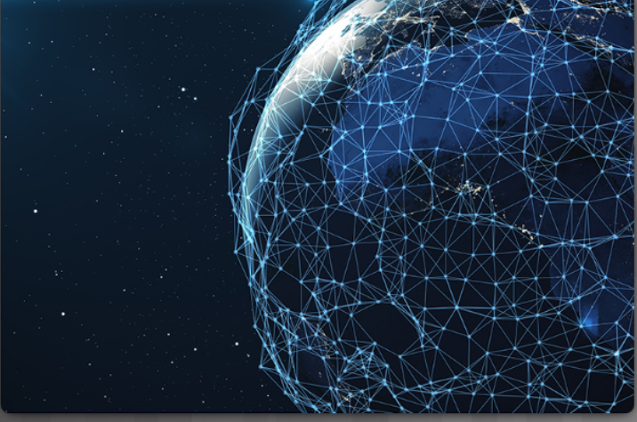
Digitization Transforms Business The Evolution of Digital Transformation
Today there are more smart devices than there are people:
Many people are connected to the Internet 24 hours a day.
By 2020 each consumer will have 6.58 smart devices.
Modern digital networks make all of this possible
Digital transformation is the application of digital technology to provide the stage for business and industry to innovate.
Notes:
1.1 – Digital Transformation
1.1.1 – Digitization Transforms Business
1.1.1.1 – The Evolution of Digital Transformation

Slide 7
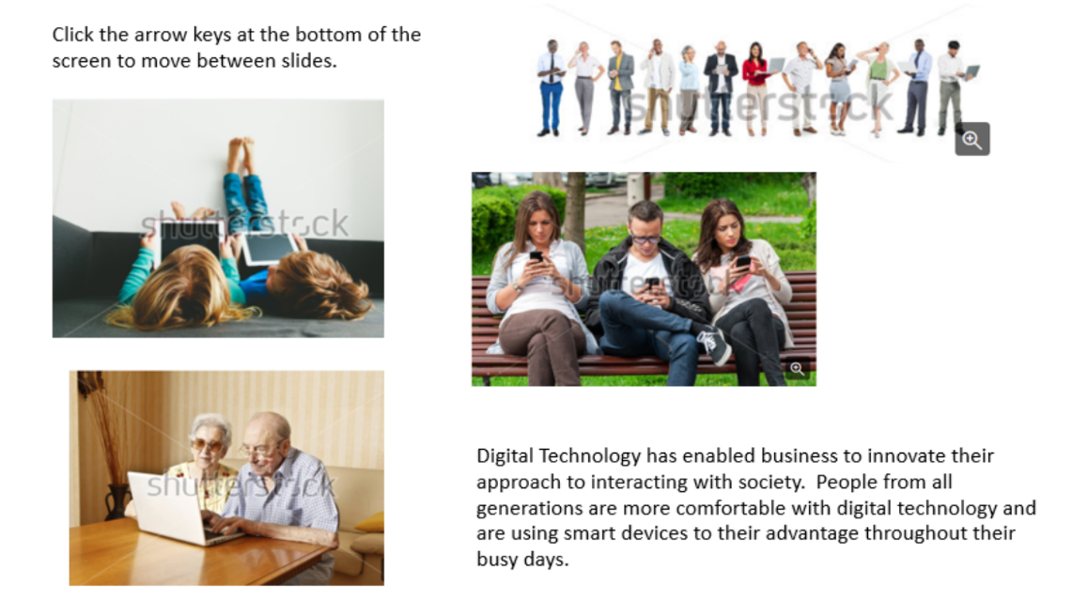
Digitization Transforms Business The Impact of Digital Transformation on Business
Notes:
1.1 – Digital Transformation
1.1.1 – Digitization Transforms Business
1.1.1.4 – The Impact of Digital Transformation on Business

Slide 8
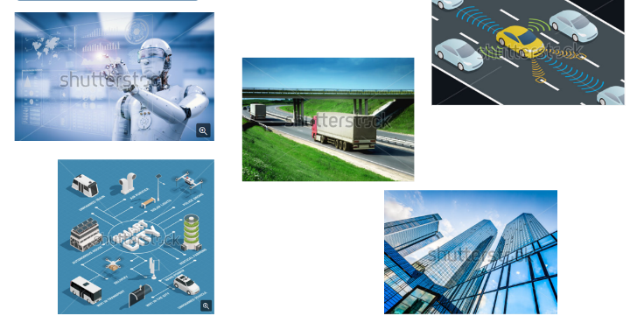
Digitization Transforms Business Can Smart Devices Think?
If programmed appropriately, smart devices are able to evaluate data that is provided to them and modify processes or settings “on the fly”.
If provided with sufficient data, they can “learn” and modify their own code based on the new parameters.
Smart Cities use sensors to control many of their infrastructure systems such as traffic flow, parking, water utilization, and hydro.
Self-driving cars are equipped with many ultrasound sensors, cameras, precision GPSs, and computers.
Notes:
1.1 – Digital Transformation
1.1.1 – Digitization Transforms Business
1.1.1.5 – Can Smart Devices Think?
1.1.1.6 – Topic Assessment

Slide 9
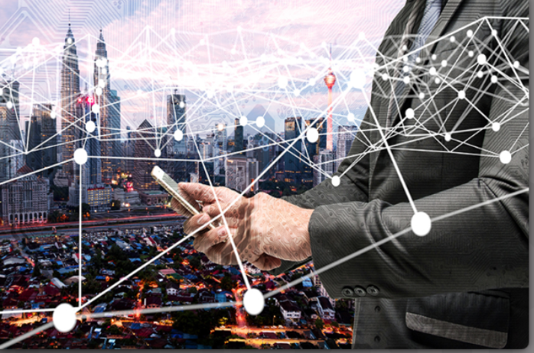
Globally Connected Through Networks Networking is the Foundation
Fifty billion things provide trillions of gigabytes of data
Networks provide the foundation for the Internet and the digitized world.
Networks can range from simple networks consisting of two computers to networks connecting millions of devices.
Networks can provide products and services to customers through their connection to the Internet.
The Internet is the largest network in existence and effectively provides the “electronic skin” that surrounds the planet.
Notes:
1.1 – Digital Transformation
1.1.2 – Globally Connected Through Networks
1.1.2.1 – Networking is the Foundation

Slide 10
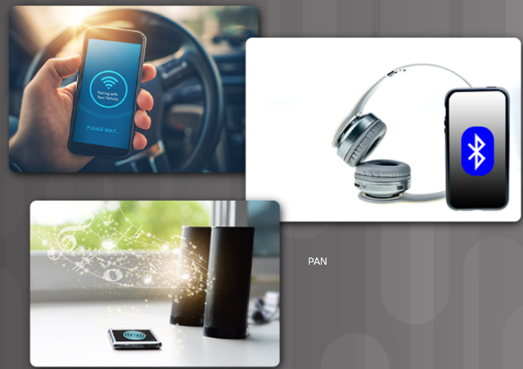
Globally Connected Through Networks Network Types
Local Area Network (LAN) - Networks in a small geographic area, such as a home or small business.
Wide Area Networks (WANs) - A collection of LANs that provides inter-LAN and Internet connectivity.
Internet - A multi-layer global network system that connects hundreds of millions of computers.
Wireless Networks - Use electromagnetic waves to carry signals over the network.
The Cloud - Data centers or groups of connected servers used to store and analyze data, provide access to on-line applications, and provide backup services.
The Edge - The physical “edge” of a corporate network.
Fog Computing - The data from IoT devices can be pre-processed for immediate use in the fog located at the edge of the network.
Personal Area Network (PAN) - Connecting your smartphone to your car using Bluetooth is an example of a PAN.
Notes:
1.1 – Digital Transformation
1.1.2 – Globally Connected Through Networks
1.1.2.2 – Network Types

Slide 11
1.2 Devices that Connect to the IoT
Notes:
1 – Everything is Connected
1.2 – Devices that Connect to the IoT

Slide 12
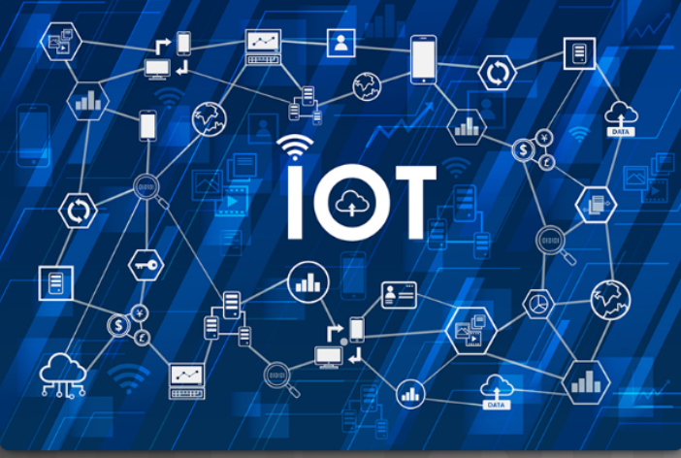
The Growth of IoT Devices What is the IoT?
The Internet of Things (IoT) is the connection of millions of smart devices and sensors connected to the Internet.
Previously inanimate objects such as doorknobs or light bulbs can now be equipped with an intelligent sensor that can collect and transfer data to a network.
An estimated 3 million new devices are connected to the Internet each month.
In the next four years, there are going to be over 50 billion connected devices worldwide.
Two-thirds will be “things”: sensors, actuators, and newly invented intelligent devices that monitor, control, analyze, and optimize our world.
Notes:
1.2 – Devices that Connect to the IoT
1.2.1 – The Growth of IoT Devices
1.2.1.1 – What is the IoT?

Slide 13
What Is IoT?
Genesis of IoT :This section highlights IoT’ s place in the evolution and development of the Internet.
IoT and Digitization:This section details the differences between IoT and digitization and defines a framework for better understanding their relationship.
IoT Impact:This section shares a few high-level scenarios and examples to demonstrate the influence IoT will have on our world.
Convergence of IT and OT :This section explores how IoT is bringing together information technology (IT) and operational technology (OT).
IoT Challenges:This section provides a brief overview of the difficulties involved in transitioning to an IoT -enabled world.

Slide 14
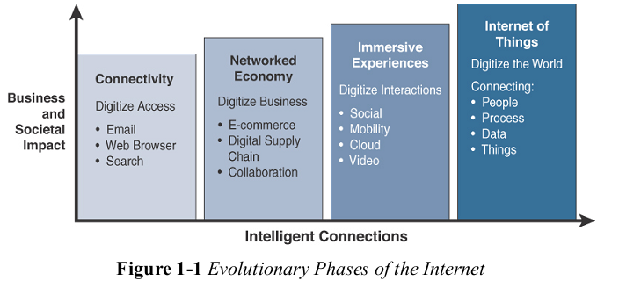
Genesis of IoT

Slide 15


IoT and Digitization

Slide 16
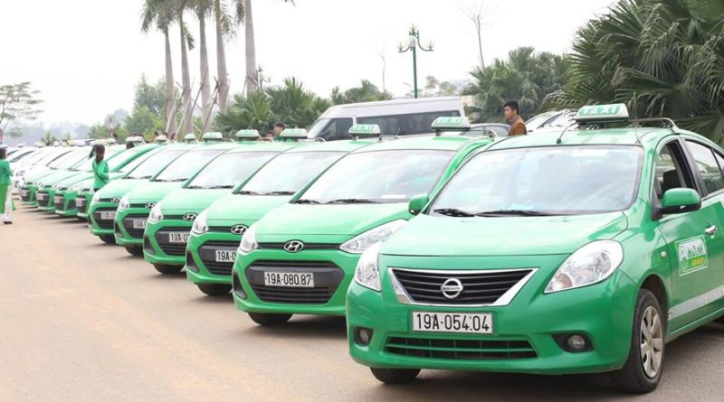
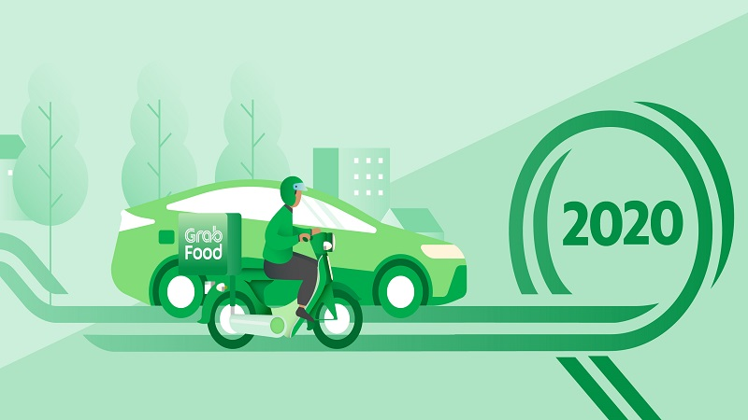
IoT and Digitization (2)

Slide 17
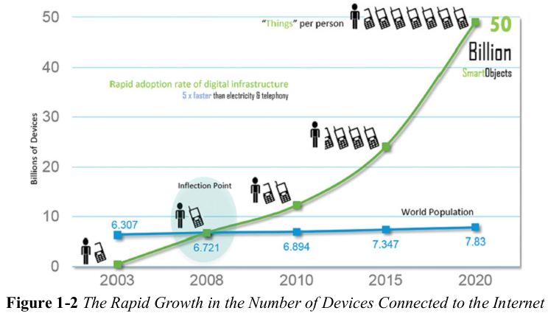
IoT impact

Slide 18
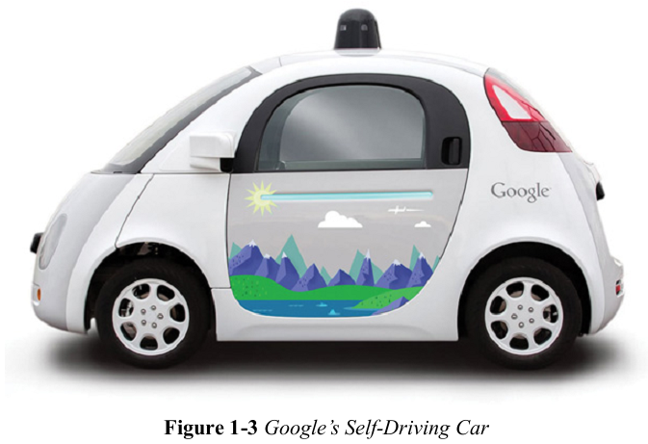
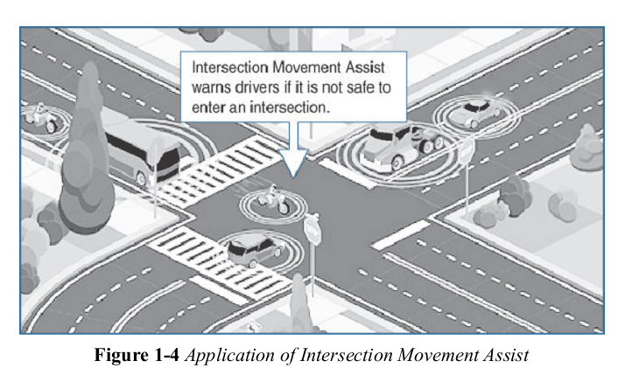
Connected Roadways

Slide 19
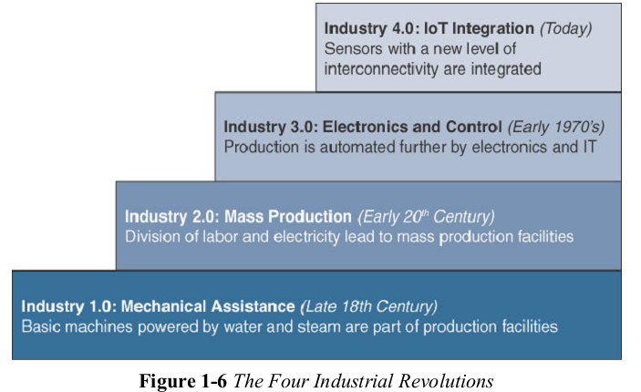
Connected Factory

Slide 20
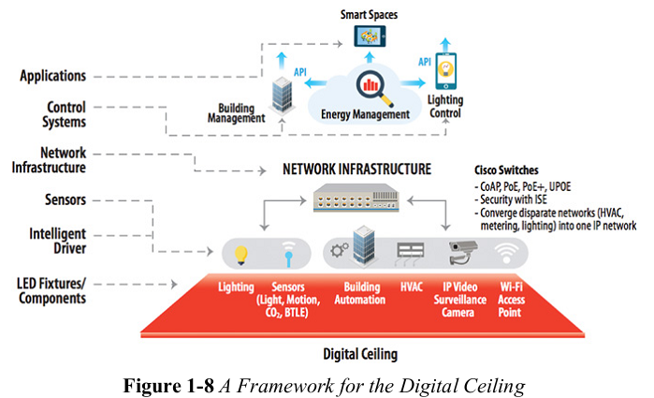
Connected building

Slide 21
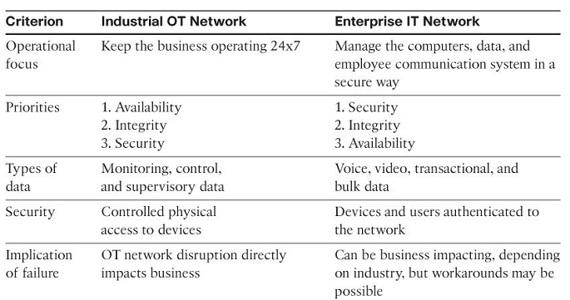
Convergence of IT and OT

Slide 22
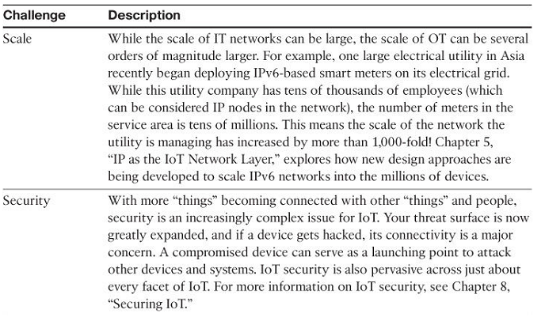
IoT Challenges

Slide 23
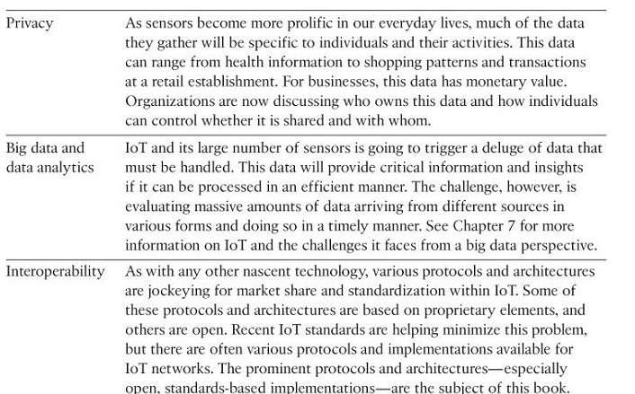

Slide 24
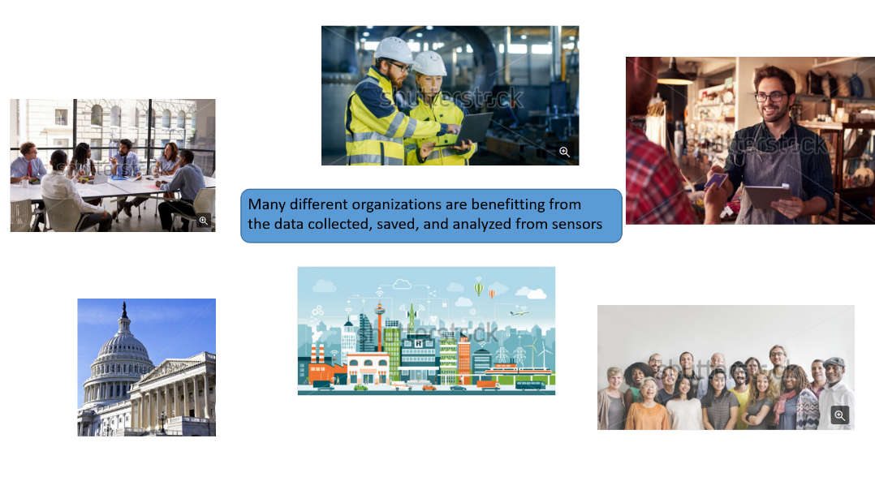
The Growth of IoT Devices What are the Benefits of Connecting these IoT Devices?
Notes:
1.2 – Devices that Connect to the IoT
1.2.1 – The Growth of IoT Devices
1.2.1.3 – What are the Benefits of Connecting these IoT Devices?

Slide 25
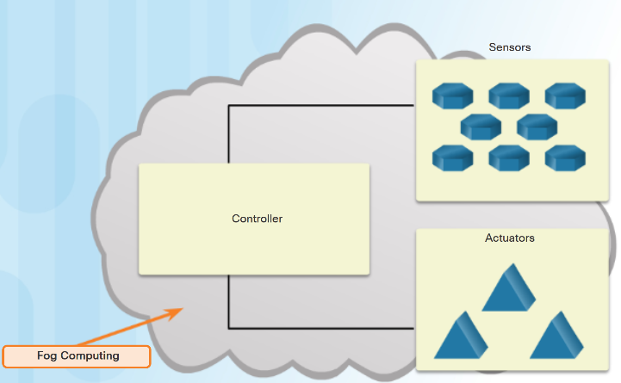
The Growth of IoT Devices How are IoT Devices Connected to the Network?
A sensor needs to be connected to a network so that the gathered data can be stored and shared.
Controllers are responsible for collecting data from sensors and providing network or Internet connectivity.
Controllers may have the ability to make immediate decisions, or they may send data to a more powerful computer for analysis.
Sensors often work together with a device called an actuator.
Actuators take electrical input and transform the input into physical action.
Notes:
1.2 – Devices that Connect to the IoT
1.2.1 – The Growth of IoT Devices
1.2.1.5 – How are IoT Devices Connected to the Network?

Slide 26
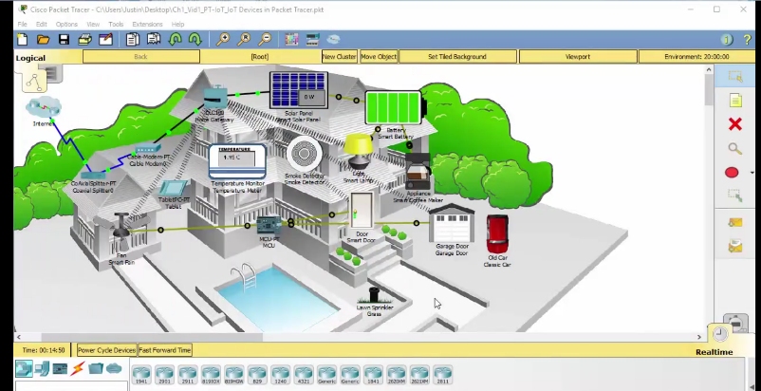
The Growth of IoT Devices Video – Explore a Smart Home
Video demonstrates how to explore a Smart home in Packet Tracer.
Packet Tracer has a wide variety of sensors and smart devices that will allow you to design smart homes, smart cities, smart factories, and smart power grids.
Notes:
1.2 – Devices that Connect to the IoT
1.2.1 – The Growth of IoT Devices
1.2.1.6 – Video – Explore a Smart Home
1.2.1.7 – Topic Assessment

Slide 27
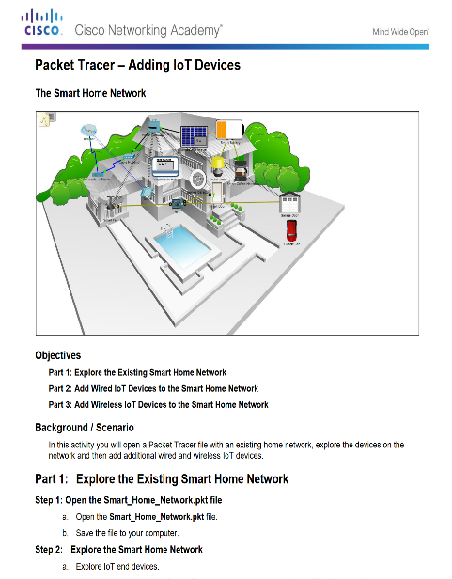
Connecting IoT Devices to the Network Packet Tracer - Add IoT Devices to a Smart Home
Notes:
1.2 – Devices that Connect to the IoT
1.2.2 – Connecting IoT Devices to the Network
1.2.2.1 – Packet Tracer -Connect an IoT Device to the Network

Slide 28
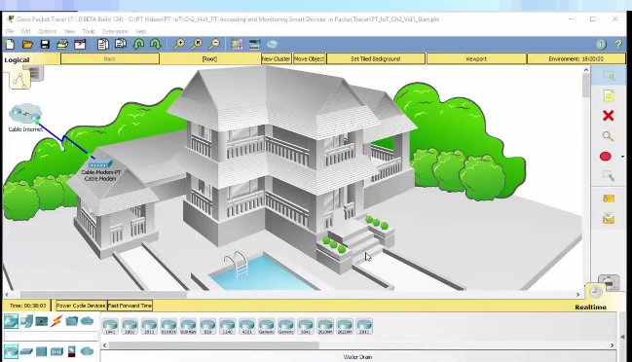
Connecting IoT Devices to the Network Connecting and Monitoring "Things"
The Home Gateway device acts as a local connection to your IoT smart devices:
It is designed to provide Internet access, wireless connectivity, and local logic for smart devices.
It provides an IoT registration service that is always turned on and an auto discovery service for Things in the local Ethernet and wireless network.
The user can control and monitor the smart devices that are connected to the Home Gateway from their smartphone, tablet, or PC.
Notes:
1.2 – Devices that Connect to the IoT
1.2.2 – Connecting IoT Devices to the Network
1.2.2.2 – Connecting and Monitoring "Things"

Slide 29
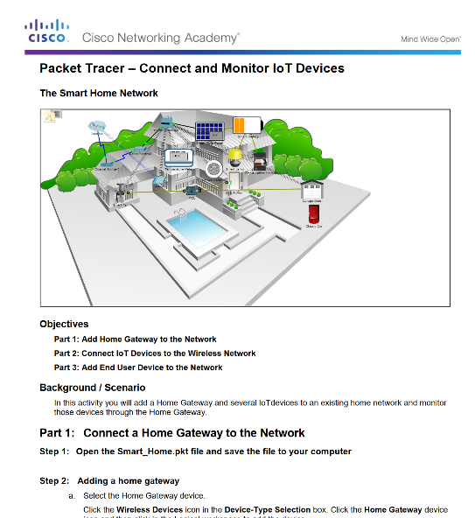
Connecting IoT Devices to the Network Packet Tracer - Connect Devices to a Home Gateway and Monitor
Notes:
1.2 – Devices that Connect to the IoT
1.2.2 – Connecting IoT Devices to the Network
1.2.2.3 – Packet Tracer - Connect Devices to a Home Gateway and Monitor

Slide 30

Connecting IoT Devices to the Network The Future of Networks
Artificial Intelligence (AI) – Devices have the ability to “think” on their own.
Intent-Based Networking (IBN) – Providing software with rules, guidelines, or intent so that data could modify the network, infrastructure features, or security features within a network.
Example - A business defines that a contract employee is given access to only a specific set of data and applications. This is the intent. In an IBN system all the network devices will be automatically configured to fulfil this requirement across the network, no matter where the employee is connected.
Notes:
1.2 – Devices that Connect to the IoT
1.2.2 – Connecting IoT Devices to the NetworkThe Future of Networks
1.2.2.4 – The Future of Networks

Slide 31
1.3 Chapter Summary
Notes:
1 – Everything is Connected
1.3 - Summary

Slide 32
Chapter Summary Summary
As digital networks continue to grow around the world, we are seeing a Digital Transformation - the application of digital technology to provide the stage for business and industry to innovate.
Sensors are now everywhere in the home, on traffic lights, in farm fields, and on our bodies. The analyzed data from sensors is used by governments, cities, businesses, and individuals to effect changes.
Networks form the foundation of the digitized world. Types of Networks:
PAN: Bluetooth
LAN
WAN: Internet, the cloud, fog computing
Wireless: WiFi, Cellular
The Internet of Things is the connection of millions of smart devices and sensors connected to the Internet.
A sensor typically connects to a controller using a wireless connection. Controllers collect data from sensors and send the data for storage or analysis. Controllers may work together with a device called an actuator. Actuators take electrical input and transform the input into physical action.
The future of networking will revolve around artificial intelligence (AI) and intent-based networking (IBN).
Notes:
1 – Everything is Connected
1.3 – Summary

